Slide 1


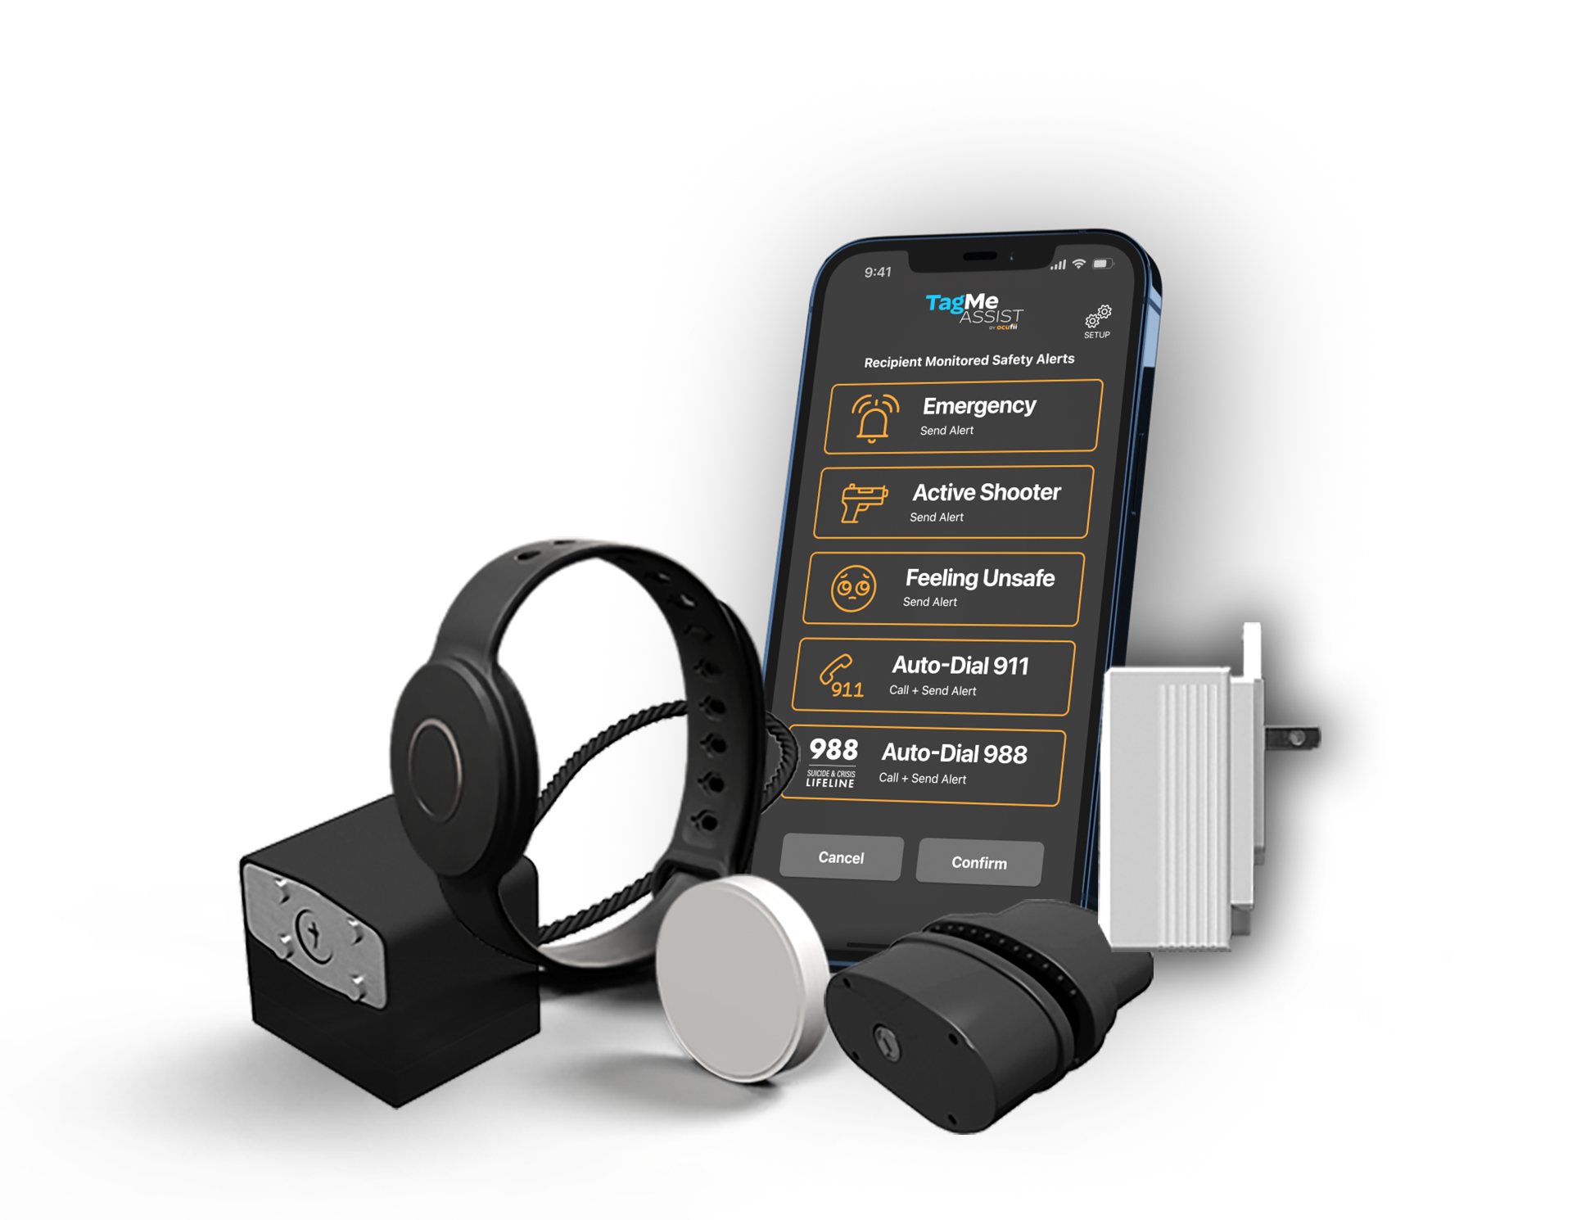
Ocufii Instructor Programs
Affiliate & Certified Instructor Partner (CIP)
Enhance Your Training. Deliver More Value. Build New Income.

Slide 2

The Opportunity for Instructors
You’re Already Teaching Safety…
Your Students trust you to guide them
They leave class – but the real world begins after
Safety doesn’t stop when training ends
What if your Training Continued Beyond the Classroom?

Slide 3




The Reality
Most Safety Incidents Happen Outside the Classroom.
What Happens When No One Is Watching?
Incidents occur at home, not during training.
No awareness when devices are accessed.
Traditional solutions don’t provide real-time insight.
Training Ends. Risk Doesn’t.

Slide 4






The Gap in Today’s Training
There’s a Disconnect
What Training Covers | What Happens After
Safety Rules | No Real-Time Awareness
Proper Handling | No Monitoring
Responsibility | No Connection to Daily Life
Students Leave Prepared-but not Connected.

Slide 5



Who is Ocufii
A Technology Platform Transforming Safety & Security
Real-Time Awareness
Connected Devices
Intelligent Alerts
Transforming Safety into a Connected Experience.

Slide 6



What we Do
Turning Safety into Awareness
Detect Activity
Send Alerts
Keep User Informed
If Something Moves, the User Knows, Instantly

Slide 7


Why This Matters to Your Students
Make Training Real.
Awareness at home
Immediate Notifications
Reinforced Safety Habits
Peace of Mind
Your Students Don’t Just Learn Safety — They Live It.

Slide 8



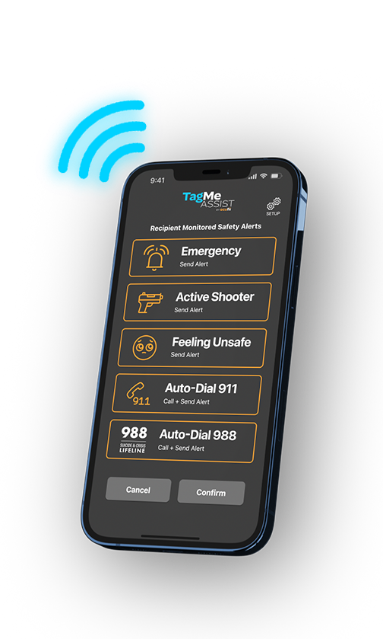

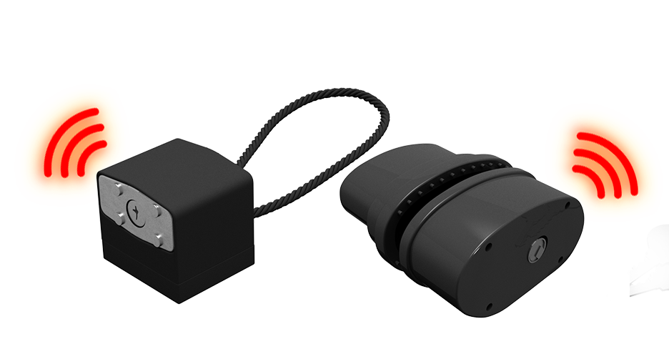
Product Ecosystem
One Platform. Three Solutions
Personal Safety
Asset Awareness
Firearm Safety
One App. One System. Complete Awareness

Slide 9




TagMe Assist (Personal Safety App)
Give your Students Real-time Safety-instantly
Send safety alerts instantly
Share location during emergencies
Connect with trusted contacts
Available to every student when they sign up
— no purchase required
Your Students Leave with More Than Training — They Leave with a Safety Tool.

Slide 10

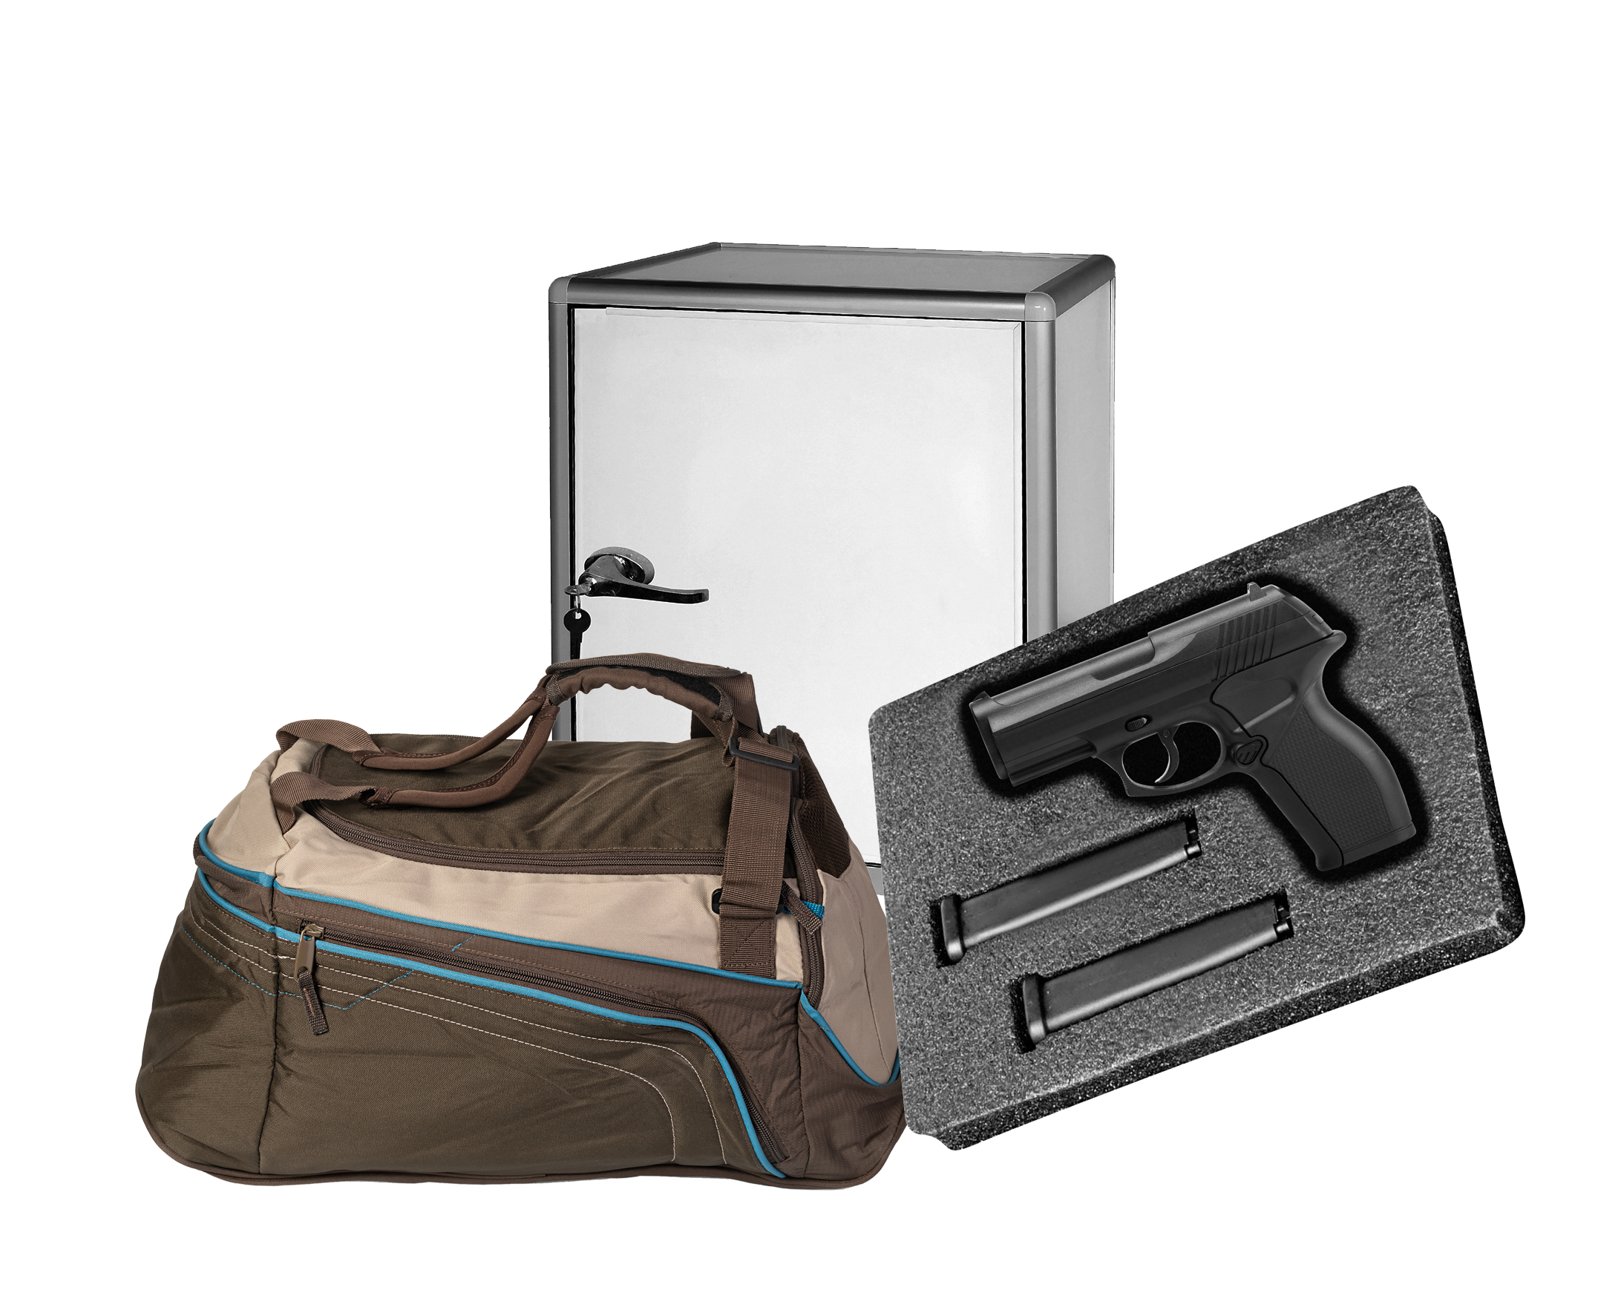

TagMe Alert (Asset Awareness)
Awareness for Everyday Items
Detects movement of valuable items
Send alerts to your phone instantly
Works from home or anywhere
Cabinets
Firearms
Protect What Matter Most-Everywhere.
Bags

Slide 11

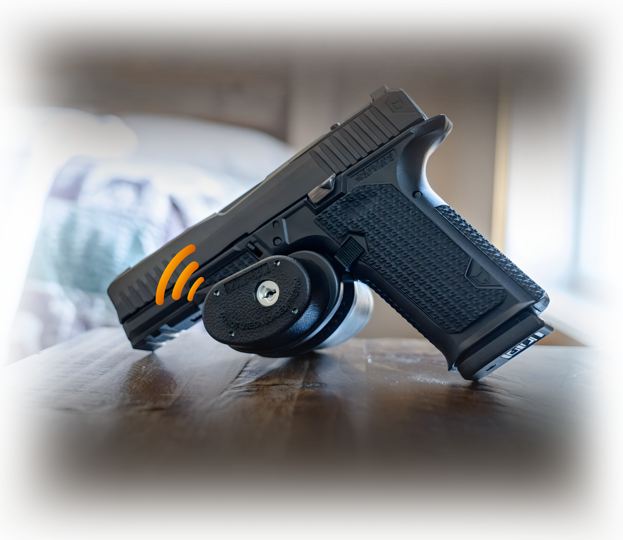


TagMe Secure (Firearm Safety)
Responsible Ownership Reinforced
Lock & awareness combined
Detects access and movement
Notifies you instantly
Adds Awareness Without Interfering With Access.

Slide 12



Keep it Simple
You Don’t Need to be Technical
Easy to explain
Easy to demonstrate
Easy for students to understand
If You Can Teach Safety — You Can Present Ocufii.

Slide 13




Why this is perfect for you
This Fits Into Your Class Naturally
Quick 2-3 minute introduction
No disruption to your class
Enhances your credibility
Adds real value to student
Seamlessly Integrate Ocufii into What You Already Do.

Slide 14



The Opportunity
Turn Every Class into More
Help your students beyond the classroom
Provide real-world solutions
Create additional income
You’re Already Doing the Work — Now Get More From It.

Slide 15
Ocufii Instructor Programs
Turn Every Class Into Added Value — For Your Students And Your Business
Help your students Improve safety at home
Enhance your training with modern technology
Earn income with zero disruption to your class

Slide 16
Ocufii Instructor Programs
Why Firearm Safety Instructors Choose Ocufii
Add real-world safety solutions students can use at home
Reinforce responsible ownership beyond the classroom
Create a new revenue stream from every class
No disruption to your training flow
Modern, technology-driven tools students expect
Backed by training, support, and ready-to-use materials
This is Not Selling.
This is Extending your Impact.

Slide 17
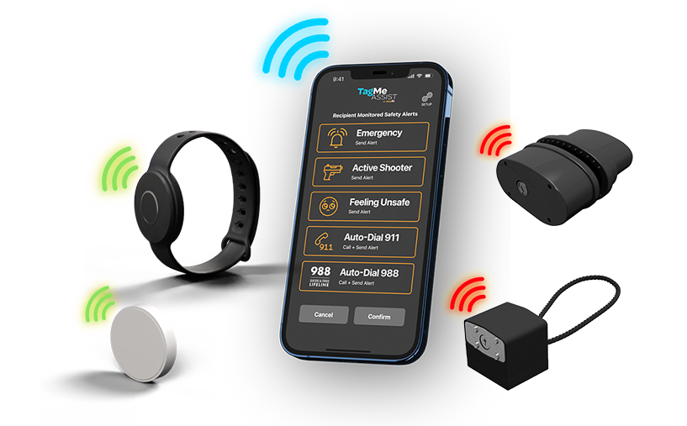
Ocufii Instructor Programs
Program 1: Affiliate Partner (Start Immediately – No Cost)
Perfect For Instructors Who Want To Introduce Ocufii With Zero Upfront Investment
How it Works:
Share Your Personal Affiliate Link with Students
Student Purchase Directly from Ocufii Online
Your Earn:
10% Commission on all Purchases
What You Do:
Mention Ocufii During Class
Share Your Link (QR Code, Email, or Verbal)
No Inventory
No Setup
No Cost to Join
Simple. Easy. Immediate Income.

Slide 18

Ocufii Instructor Programs
Program 2: Certified Trainer (Upgrade your impact & income)
Invest In The Ocufii Trainer Kit ($300) And Turn Your Class Into a Hands-on Experience
You earn:
$25 per class (while recovering your kit investment)
20% commission on all purchases
After recovery: $20 per class + 20% commission
What’s included:
10% commission on all purchases
What you do:
Product samples (display + demo)
Branded banner + display materials
Professional setup to showcase in class
What you do:
Creates credibility
Drives higher conversions
Positions you as a modern safety leader

Slide 19
Ocufii Trainer kit ROI (Recover your investment- start earning more!)
Invest Once. Start Generating Income From Every Class You Already Teach.
Your Investments:
$300 One-time Cost for the Ocufii Trainer Kit
Your Earn (During Recovery):
$25 Per Class
20% Commission on all Purchases
Break-even In ~12 Classes
  ($25 X 12 Classes = $300 + Commissions)
After you Break Even:
$20 Per Class
20% Commission Continues on Every Sale
Ongoing Income from Every Class you Teach
What This Matters:
Rapid Return On Your Investment
Higher Earnings With Every Class
Adds Value Without Changing Your Training
Create Long-term Recurring Income Potential
Simple Reality: You’re Already Teaching The Class. Now Every Class Becomes A Revenue Opportunity

Slide 20

Ocufii Instructor Programs
How To Get Started
Get Started In Minutes
Step 1:
Sign up for the Ocufii Affiliate Program
Scan QR Code or Visit Link
Step 2:
Start as an Affiliate (No Cost) or
Step 3 (Optional Upgrade):
Order Instructor Kit and become a Certified Instructor Partner
What You Do:
Start Earning Immediately
Upgrade when Ready
No Risk, only Upside
https://www.avantlink.com/invite/ocufii/35665
You’re Already Teaching Safety. Now you can Extend it Beyond the Classroom — and Get Rewarded for it.

Slide 21




What Ocufii Handles
We Handle Everything
Fulfillment
Shipping & Delivery
Customer Support
Technology Platform
You Focus on Teaching — We Handle the Rest.

Slide 22



Your Path to get Started
Simple to get started
Step 1
Join as an Affiliate
Step 2
Start Sharing with Students
Step 3 (Optional)
Upgrade to CIP When Ready
Enhance Your Classes. Expand Your Income. Make an Impact.

Slide 23

Deliver More. Earn More. Make a Bigger Impact.
Your Students Win
You Grow Your Income
You Extend Your Reach
Let’s Bring Real-World Safety into Every Class.

